Slide 1
Notes:
demetres

Slide 2

Social Publishing System
Χαράλαμπος Χαραλάμπους
Πασχάλης Μπέης
Δημήτρης Χριστοφή
Καθηγητής : Μάριος Δικαιάκος
Λευκωσία, Μάιος 2013
Notes:
demetres

Slide 3

Social publishing
Social publishing unites audiences and builds communities around great content.
Blend of three categories
- Web Content Management
-Social Software (blogs, wikis, social networking platforms, forums, etc.)
-Web application frameworks
Notes:
demetres

Slide 4
The concept of our project
A social publishing system independent from other social networks
Encourage users to add their personal journals
Offer a user friendly environment and smart design
A website adapted to new technologies and new marketing needs
Notes:
demetres

Slide 5


MySQL
MySQL + PHP, you can connect to and manipulate databases
The most popular database system used with PHP
Database system used on Web
Runs on a server
Very fast, reliable, easy to use
Supports standard SQL
Compiles on the most platforms
Notes:
Dimitris

Slide 6


PHP (Hypertext Preprocessor)
Server scripting language
Powerful tool for making dynamic and interactive Web pages
Can edit files on the server (create, open, read, write, close)
Add, delete, modify data in DB
Runs on different platforms
Support a wide range of DBs
Data encryption
Notes:
Demetros
PHP scripts are executed on the server

Slide 7


HTML & CSS
Hypertext Markup Language (HTML)
The main markup language for creating websites
Written in the form of HTML elements consisting of tags enclosed in angle brackets
Browsers read HTML docs & compose them into visible or audible web pages
Cascading Style Sheets (CSS)
Style sheet language
Simple mechanism for adding style to Web documents
Style (e.g. fonts, colors, spacing)
Notes:
demetres

Slide 8


JavaScript
jQuery
Interpreted computer programming language
Prototype-based scripting language
It’s dynamic, weakly typed and has first-class functions
Website usage
-load new page content via AJAX
-animation of page elements
-interactive content
-validating input of web forms
JavaScript Library
Greatly simplifies JS Programming
Easy to learn (“write less, do more”)
Lightweight
More than 55% of 10 000 most visited websites use it.
Notes:
demetres

Slide 9


JSON
AJAX
JavaScript Object Notation
Syntax for storing & exchanging text information (like XML)
Smaller than XML, and faster and easier to parse
Self-describing
Hierarchical
JSON data can be transported using AJAX
Asynchronous JavaScript & XML
NOT a new programming language
But a new way to use existing standards
The art of exchanging data with a server, and updating parts of a webpage, without reloading the whole page
Used by:
Google Maps, Gmail, YouTube, Facebook tabs.
Notes:
demetres

Slide 10


Twitter Bootstrap
Twitter Bootstrap
Collection of tools for creating websites and web applications
Contains HTML and CSS-based design templates
Most popular project in GitHub
Notes:
paschalis

Slide 11
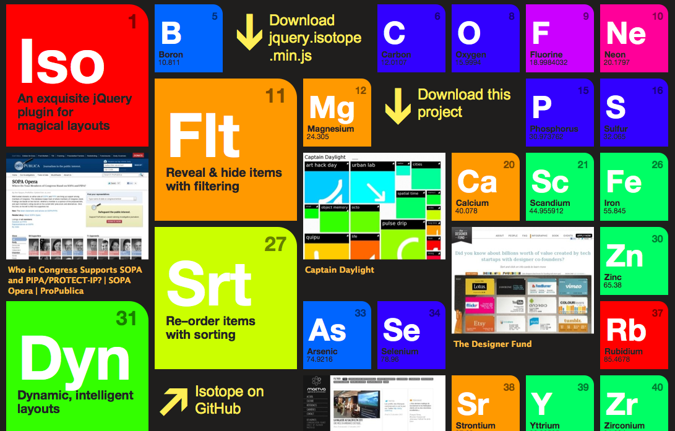
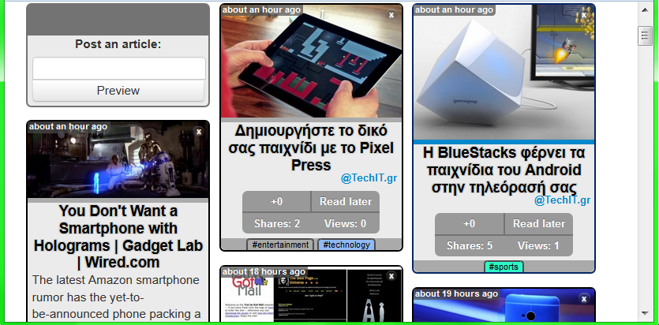
Isotope
Dynamic Layouts
Intellligent, dynamic layouts
Filtering
Hide & Reveal elements easily
JQuery selectors
Sorting
Re-order item elements with sorting
Notes:
paschalis

Slide 12

Project Name : SocioPub
Social Publishing website
Users can post their own content, either articles from other websites they liked and they want to share or their personal journals
Every article is shown as an abstract of the original one
Users connect to other users sharing their content
Notes:
Paschalis

Slide 13
Main features
Article’s value can be measured in multiple ways(likes , shares , views)
Articles can be aligned in many ways(chronological order , device resolution and size , auto-alignment when window size changes)
Content filtering according to categories , sources and other measures
Search ability using any preferred keywords
Notes:
Paschalis

Slide 14
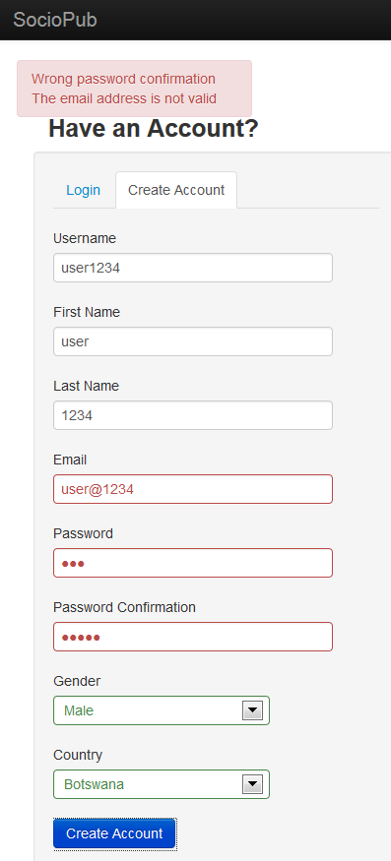
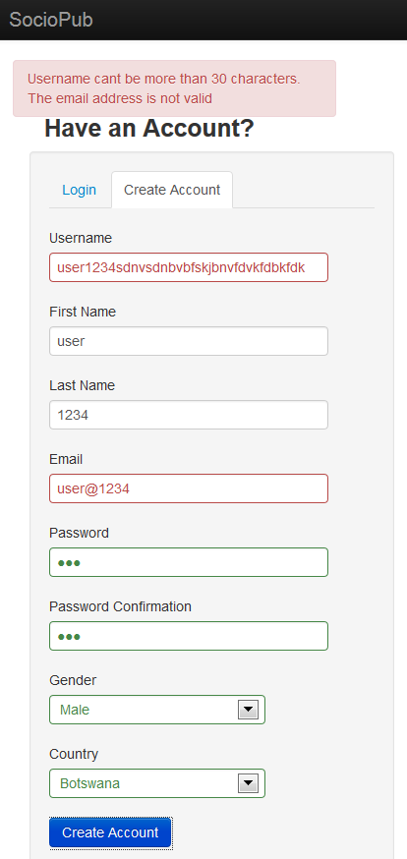
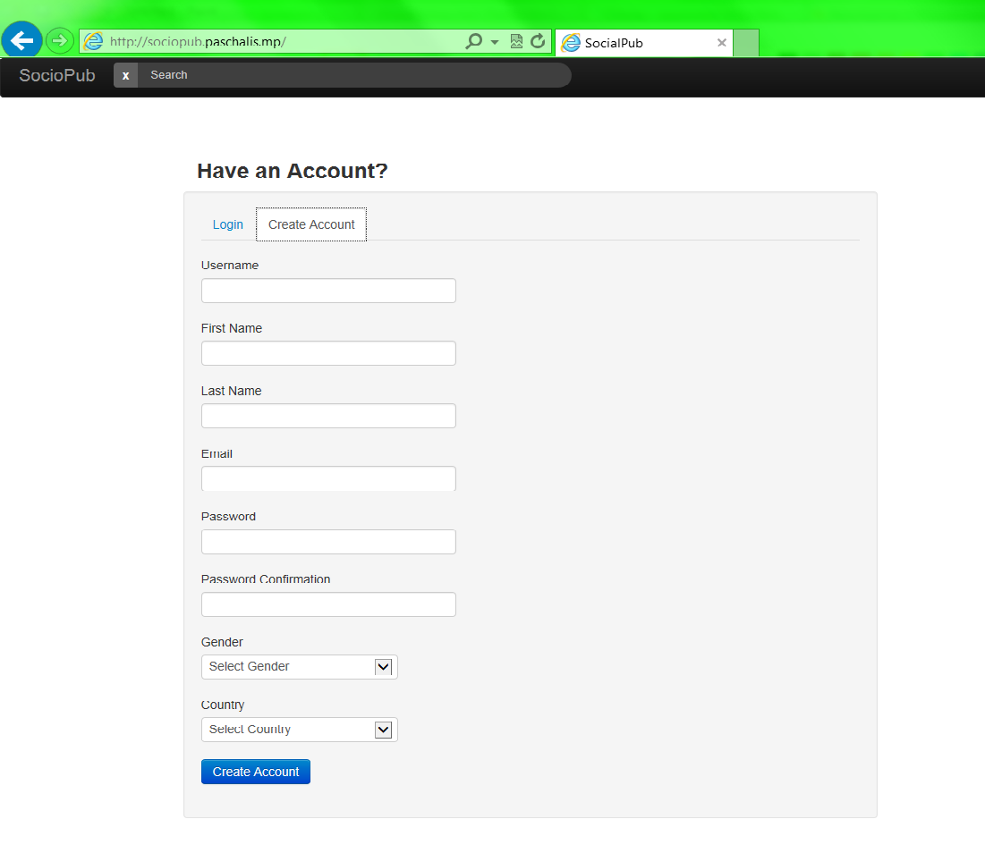
Create Account
ERRORS
Συμπλήρωση της φόρμας για δημιουργία λογαριασμού
Notes:
Paschalis

Slide 15
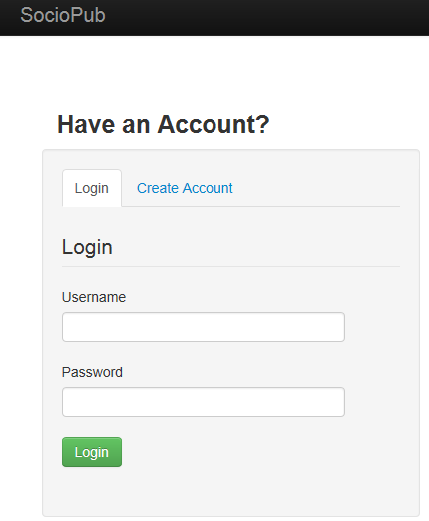
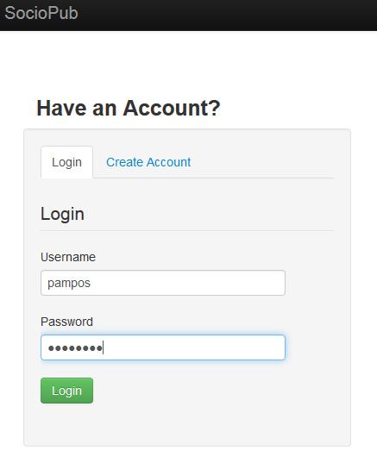
Login
Notes:
Paschalis

Slide 16
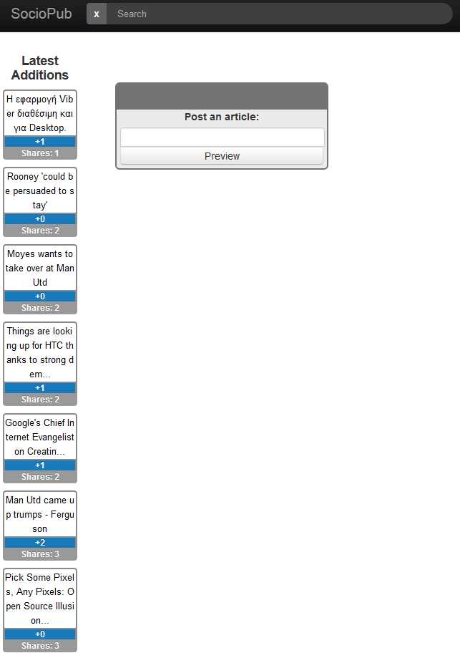
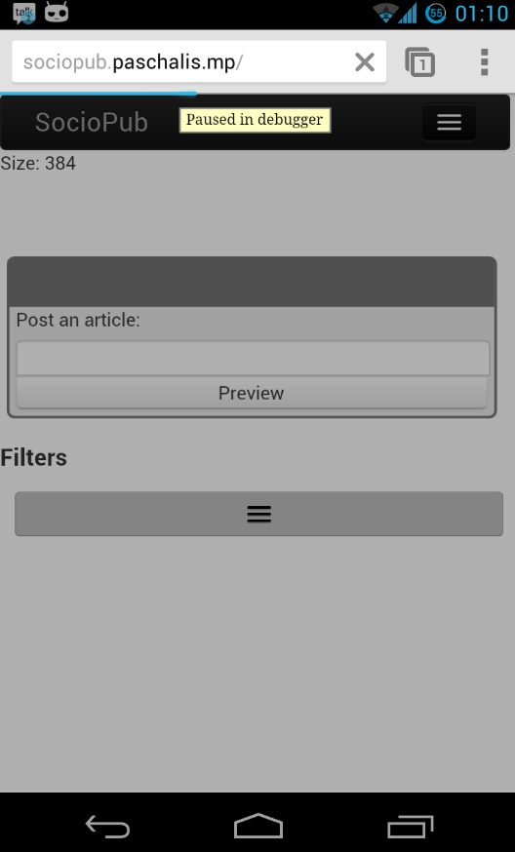
First time login
No articles yet
Latest articles of other users on the left
Post an article windows
Notes:
Paschalis ws dame

Slide 17
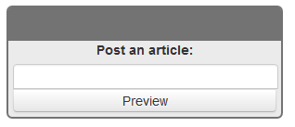

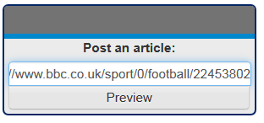
Post an article
Notes:
pampos

Slide 18
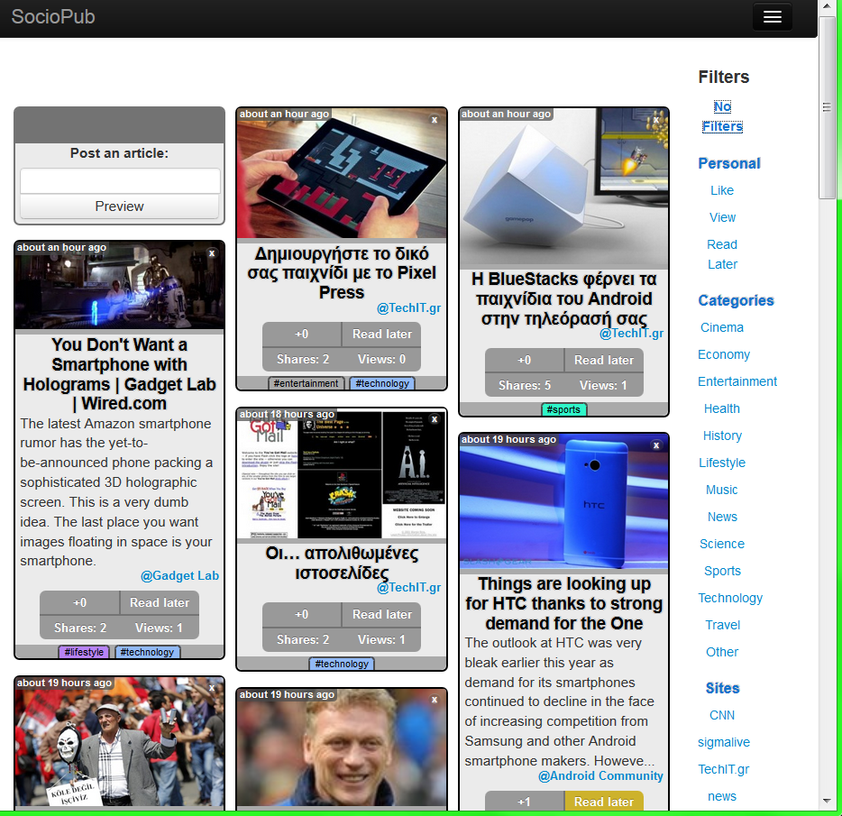
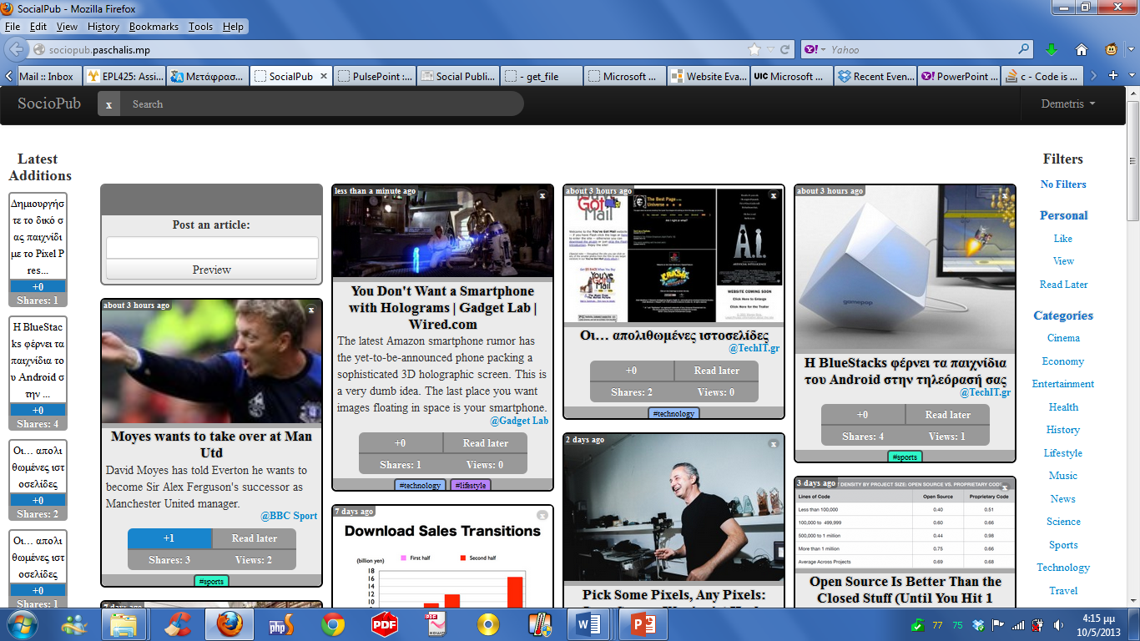
Alignment
Notes:
pampos

Slide 19
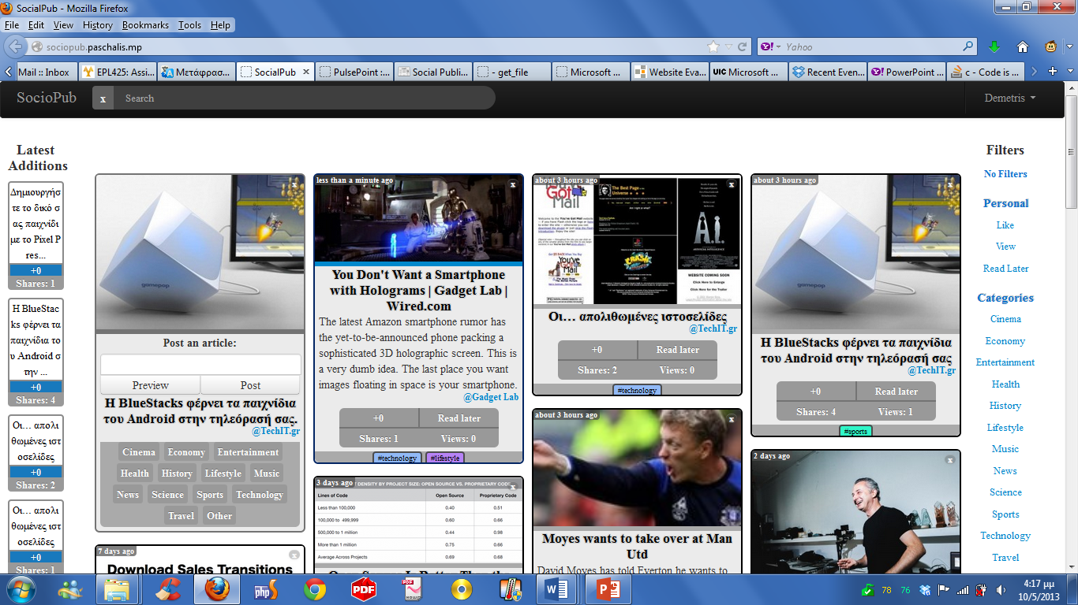
Sharing
Notes:
pampos

Slide 20
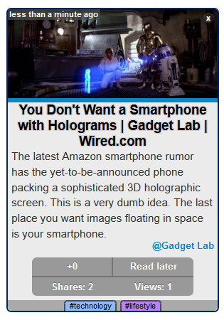
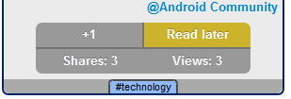
Article features
Notes:
pampos

Slide 21
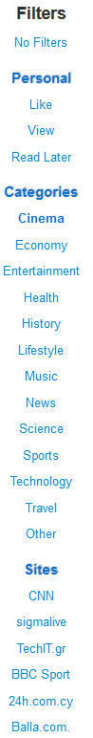
Filters
Notes:
pampos

Slide 22
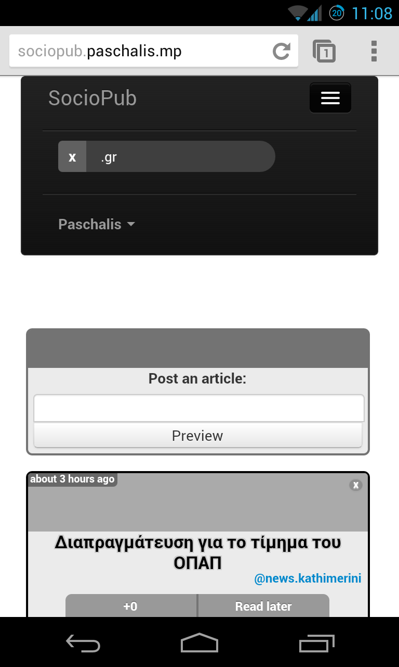
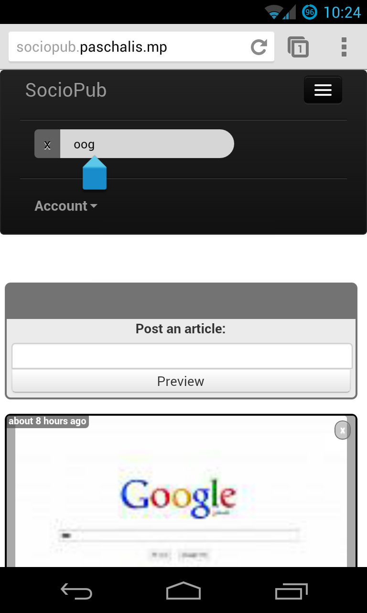
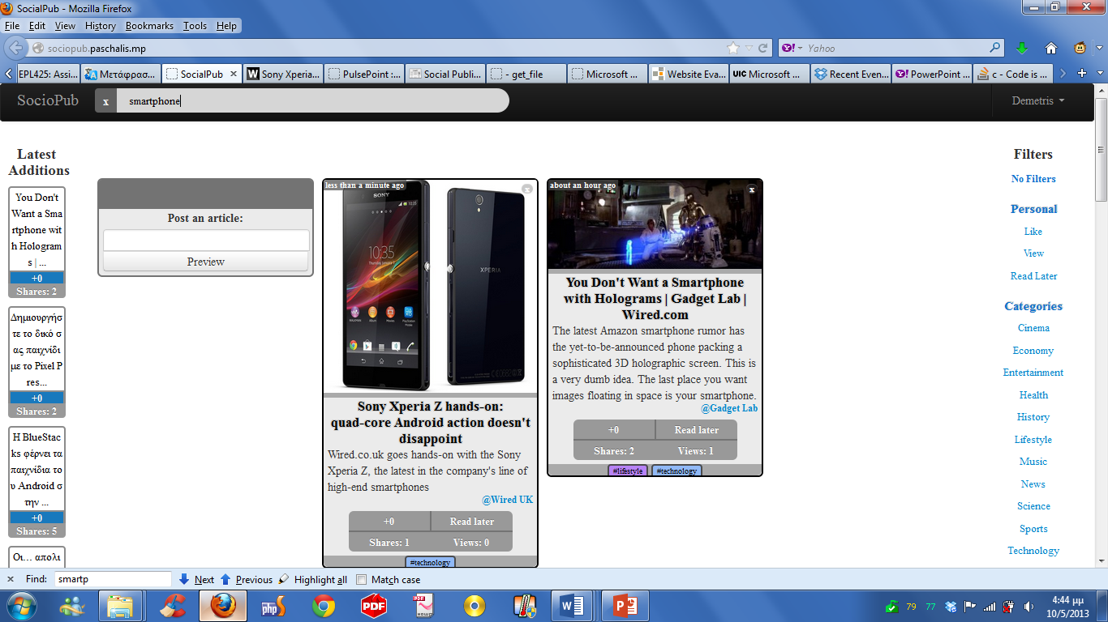
Search
Mobile
Notes:
pampos

Slide 23
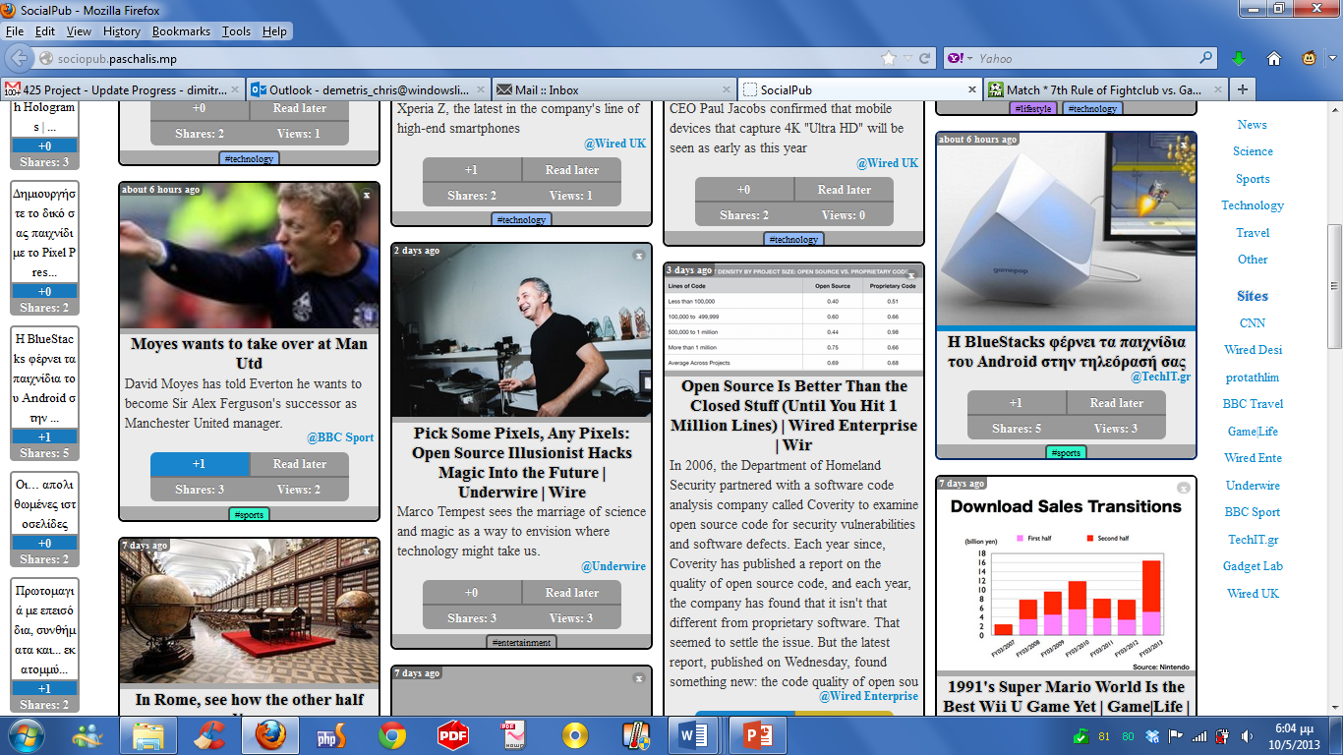
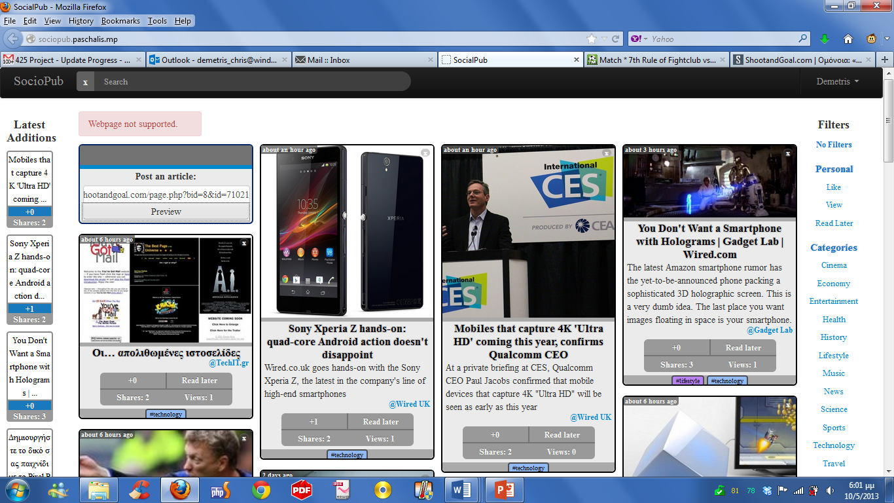
Article manipulation
Notes:
pampos

Slide 24
Conclusions
Fully functional website ready for official use
Modern design adjusted to new technologies
Future extensions
Social network buttons ( Facebook like , google plus +1, retweet)
Connect with other users for better communication (messages , chat , forum)
Help , about , settings features
Notes:
Conclusion: dimitris
Future: Paschalis Questions: Pampos

Slide 25

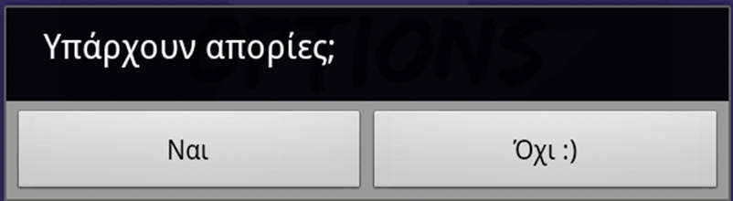

Any Questions

